Slide 1
Practical Byzantine Fault Tolerance
(The Byzantine Generals Problem)

Slide 2
Introduction
Malicious attacks and software errors that can cause arbitrary behaviors of faulty nodes are increasingly common
Previous solutions assumed synchronous system and/or were too slow to be practical
- e.g. Rampart, OM, SM
This paper describes a new replication algorithm that tolerates Byzantine faults and practical (asynchronous environment, better performance)
Why PBFT is practical (compared to the solutions from the Byzantine Generals Problem)

Slide 3







The Byzantine Generals Problem
Attack!
No, wait! Surrender!
Wait…
Attack!
Attack!
Wait…
From cs4410 fall 08 lecture

Slide 4
The Byzantine Generals Problem
A commanding general must send an order to his n-1 lieutenant generals such that
-IC1. All loyal lieutenants obey the same order.
-IC2. If the commanding general is loyal, then every loyal lieutenant obeys the order he sends.

Slide 5
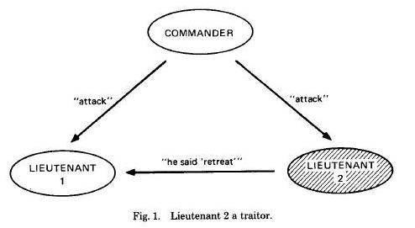
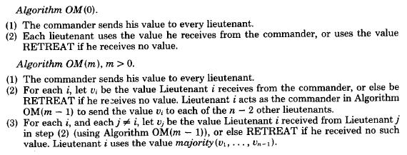
Byzantine Generals Problem
Attack!
Attack? Retreat?

Slide 6
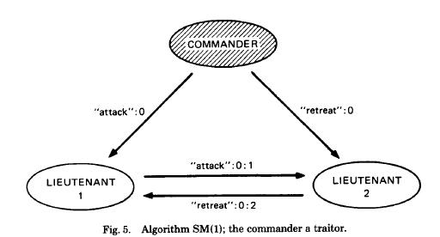
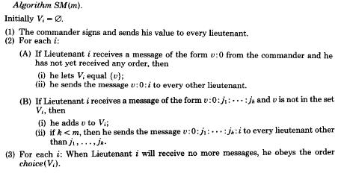
Byzantine Generals Problem

Slide 7
Byzantine Generals Problem
Theorem 1. For any m, Algorithm OM(m) satisfies conditions IC1 and IC2 if there are more than 3m generals and at most m traitors
Theorem 2. For any m, Algorithm SM(m) solves the Byzantine Generals Problem if there are at most m traitors
Both require message paths of length up to m+1 (very expensive)
Both require that absence of messages must be detected (A3) via time-out (vulnerable to DoS)

Slide 8
System Model
Asynchronous distributed system where nodes are connected by a network
Byzantine failure model
- faulty nodes behave arbitrarily
- independent node failures
Cryptographic techniques to prevent spoofing and replays and to detect corrupted messages
Very strong adversary

Slide 9
Service Properties
Any deterministic replicated service with a state and some operations
Assuming less than one-third of replicas are faulty
- safety (linearizability)
- liveness (assuming delay(t) >> t)
Access control to guard against faulty client
The resiliency (3f+1) of this algorithm is proven to be optimal for an asynchronous system

Slide 10


The Algorithm
Basic setup:
-
- A view is a configuration of replicas (a primary and backups):
- Each replica is deterministic and starts with the same initial state
- The state of each replica includes the state of the service, a message log of accepted messages, and a view number

Slide 11
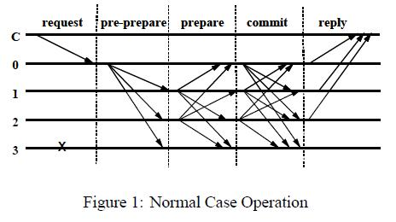

The Algorithm
1. A client sends a request to invoke a service operation to the primary
o= requested operation
t= timestamp
c= client
ϭ= signature

Slide 12
The Algorithm
2. The primary multicasts the request to the backups (three-phase protocol)

Slide 13
The Algorithm
3. Replicas execute the request and send a reply to the client
o= requested operation
t= timestamp
c= client
ϭ= signature
v= view
i= replica
r= result

Slide 14
The Algorithm
4. The client waits for f+1 replies from different replicas with the same result; this is the result of the operation

Slide 15
Three-phase Protocol
1.pre-prepare
- primary assigns n to the request; multicasts pp
- request message m is piggy-backed (request itself is not included in pp)
- accepted by backup if:
- the messages are properly signed;
- it is in the same view v;
- the backup has not accepted a pp for the same v and n with different d
- h <= n <= H
- if accepted, then replica i enters prepare phase

Slide 16
Three-phase Protocol
2.prepare
- if backup accepts pp, multicasts p
- accepted by backup if:
- message signature is correct;
- in the same view;
- h<= n<= H
- prepared(m,v,n,i) is true if i has logged:
- request message m
- pp for m in v
- 2f matching prepares with the same (v,n,d)
- if prepared becomes true, multicasts commit message and enters commit phase

Slide 17
Three-phase Protocol
Pre-prepare – prepare phases ensure the following invariant:
- if prepared(m,v,n,i) is true then prepared(m’,v,n,j) is false for any non-faulty replica j (inc. i=j) and any m’ such that D(m’) != D(m)
i.e. ensures requests in the same view are totally ordered (over all non-faulty replicas)

Slide 18
Three-phase Protocol
3.commit
- accepted by backup if:
- message signature is correct;
- in the same view;
- h<= n<= H
- committed(m,v,n) is true iff prepared(m,v,n,i) is true for all i in some set of f+1 non-faulty replicas
- committed-local(m,v,n,i) is true iff prepared(m,v,n,i) is true and i has accepted 2f+1 matching commits
- replica i executes the operation requested by m after committed-local(m,v,n,i) is true and i’s state reflects the sequential execution of all requests with lower n

Slide 19
Three-phase Protocol
Commit phase ensures the following invariant:
- if committed-local(m,v,n,i) is true for some non-faulty i then committed(m,v,n) is true
i.e. any locally committed request will eventually commit at f+1 or more non-faulty replicas
The invariant and view change protocol ensure that non-faulty replicas agree on the sequence numbers of requests that commit locally even if they commit in different views at each replica
Prepare – commit phases ensure requests that commit are totally ordered across views

Slide 20
The Algorithm
Garbage Collection
- must ensure the safety still holds after discarding messages from log
- generates checkpoint (a snapshot of the state) every once in a while
- when a replica generates a checkpoint, it multicasts checkpoint message with seq number and digest of state; if a replica receives 2f+1 matching checkpoint messages, the checkpoint becomes stable and any messages associated with seq numbers less than that of the checkpoint are discarded
View Changes
- provides liveness
- triggered by timeout to prevent backups from waiting forever
- timer starts when backup receives a valid request; it stops when the replica is no longer waiting to execute the request
- with commit phase invariant, view change guarantees total ordering of requests across views (by exchanging checkpoint information across views)

Slide 21
The Algorithm
The algorithm provides safety if all non-faulty replicas agree on the sequence numbers of requests that commit locally
To provide liveness, replicas must change view if they are unable to execute a request
- avoid view changes that is too soon or too late; the fact that faulty replicas can’t force frequent view changes will guarantee liveness unless message delays grow faster than the timeout period indefinitely

Slide 22
Optimizations
Reducing Communication
- avoids sending most of large replies
- only designated replica send the result
- reduces the number of message delays for an operation invocation from 5 to 4
- execute a request tentatively if prepared
- client waits for matching 2f+1 tentative replies
- improves the performance of read-only operations
- client multicasts a read-only request to all
- replicas execute it immediately in tentative state
- send back replies after requests reflected in the tentative state commit
- client waits for 2f+1 replies with the same result

Slide 23
Optimizations
Cryptography
- digital signatures used only for view-change and new-view messages (but view change is not implemented!)
- authenticate all other messages using message authentication codes (MACs)

Slide 24
Implementation
The Replication Library
- basis for any replication service
- client: invoke
- server: execute, make_checkpoint, delete_checkpoint, get_digest, get_checkpoint, set_checkpoint
- point-to-point communication using UDP
- view change and retransmission can be used to recover from lost messages
- It does not implement view-change or retransmission at present, but this does not compromise the accuracy of the results

Slide 25
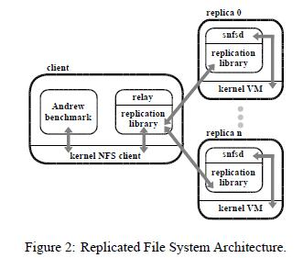
Implementation
A Byzantine-Fault-tolerant File System

Slide 26
Implementation
Maintaining Checkpoints
- snfsd uses direct file system operations on memory mapped file system to preserve locality
- checkpoint record (n, list of modified blocks, d) that keeps update information for the corresponding checkpoint
- snfsd keeps a copy-on-write bit for every 512-byte block
- copy-on-write technique to reduce space and time overhead in maintaining checkpoints
Computing Checkpoint Digests
- AdHash: sum of digest of each block (index+value)
- efficient for a small number of modified blocks

Slide 27
Performance Evaluation
Micro-benchmark: invoke null-op; provides service independent evaluation of the performance of the replication library
Andrew-benchmark: emulates a software development workload; compares BFS with NFS V2 and BFS without replication
Measured normal-case behaviors(i.e. no view changes) in an isolated network with 4 replicas
- the first correct replicated service in asynchronous environment like internet?!
- can tolerate Byzantine faults (liveness) with comparable normal-behavior performance?!

Slide 28
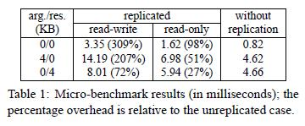
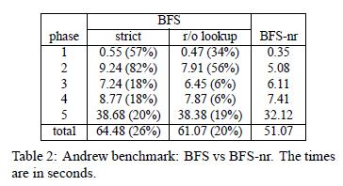
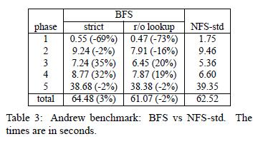
Performance Evaluation

Slide 29
Conclusion
PBFT is the first replicated system that works correctly in asynchronous system like internet and it improves performance of previous algorithms by more than an order of magnitude
OM-SM algorithms are too slow to be used in practical (proportional to the number of faulty nodes vs. number of phases)

